Slide 1
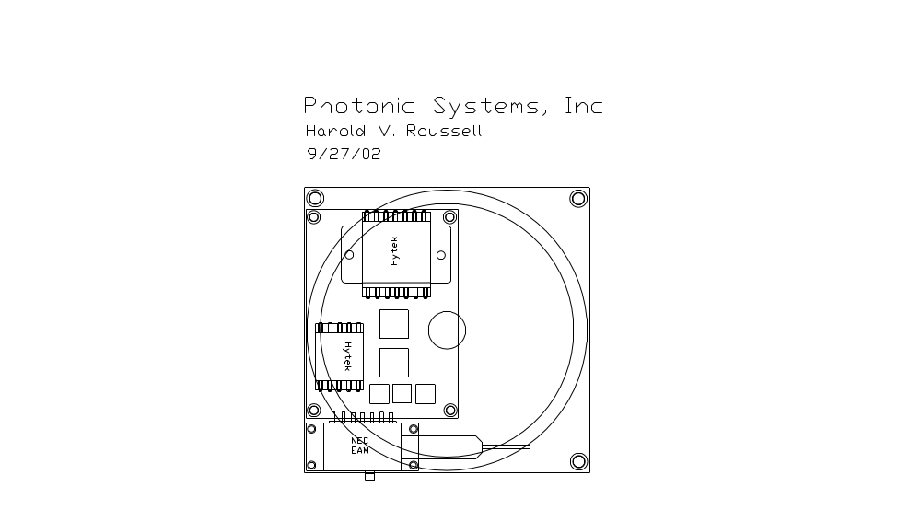
OTX board layout
OTX base plate with mounting screws, size 3” x 3”
Fiber storage
Fiber can come off in any direction
GPO RF interface

